Slide 1

SQL: SELECT (cont.)
Example 1: find the name and address of employees working in the ‘Research’ department
The following is the equivalence query in Relational Algebra:
SELECT fname, lname, address
FROM Employee, Departemnt
WHERE dno = dnumber AND dname = ‘Research’

Slide 2
SQL: SELECT (cont.)
Example 2: For the projects located in 'Stafford', find the name of the project, the name of the controlling department, the last name of the department's manager, his address and birthdate
Projects in 'Stafford' can be found as follows:
SELECT pnumber, pname, plocation
FROM project
WHERE plocation = 'Stafford';
The controlling department of these projects is added as follows:
SELECT pnumber, pname, dname, mgrssn
FROM project, department
WHERE dnum = dnumber AND plocation = 'Stafford';
Finally, the manager information is added as follows:
SELECT pname, dname, lname, address bdate
FROM project, department, employee
WHERE dnum = dnumber AND mgrssn = ssn AND plocation = 'Stafford';

Slide 3
Qualifying Attribute with Relation Names and Aliasing
Ambiguous attribute names:
Attributes in different relations can have the same attribute name.
Example:
When Works_on and Dependent relations appear in the same query, the attribute name Essn will be ambiguous
Find project numbers of projects worked on by employees who has a daughter names ‘Alice’
Works_on (Essn, Pno, Hours);
Dependent (Essn, Dependent_name, Sex, Bdate, Relationship);
SELECT Pno
FROM Works_on, Dependent
WHERE Essn = Essn AND name = ‘Alice’
(You cannot tell that Essn is an attribute from the Project relation or from the Dependent relation

Slide 4

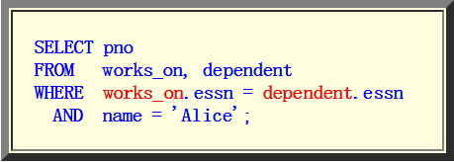
Solving the Ambiguous Attribute Names from Different Relations
When different relations has a common attribute name, we can make that name un-ambiguous by:
Qualifying (= prefixing) the attribute name with the source relation name.
Example:

Slide 5
Aliasing: qualifying attribute names from the same relation
Fact:
Sometimes, we need to use the same relation multiple times in a SELECT command
Every attribute name of that relation will be ambiguous
Example: for each employee, retrieve the employee’s first and last name and the first and last name of his or her immediate supervisor.
SELECT Employee.Fname, Employee.Lname, Employee.Fname, Employee.Lname
FROM Employee, Employee
WHERE Employee.Super_ssn = Employee.Ssn;
Notes:
Qualifying an attribute names with the relation name will not make the attribute name un-ambiguous
(Because it's the same relation name !!!)

Slide 6
Aliasing: qualifying attribute names from the same relation (cont.)
Alias: solving ambiguous name from the same relation
For each employee, retrieve the employee’s first and last name and the first and last name of his or her immediate supervisor
SELECT E.fname, E.lname, S.fname, S.lname
FROM Employee AS E, Employee AS S
WHERE E.superssn = S.ssn;
This practice is recommended since it results in queries that are easier to comprehend.
Notes:
Qualifying an attribute names with the relation name will not make the attribute name un-ambiguous
(Because it's the same relation name !!!)

Slide 7
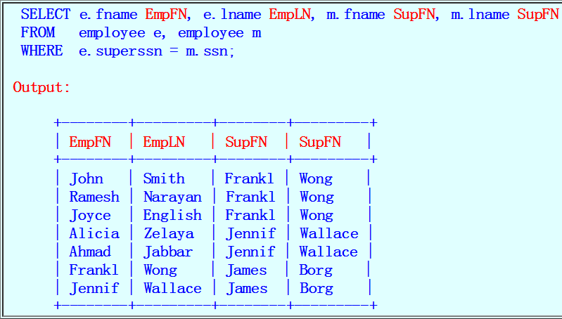
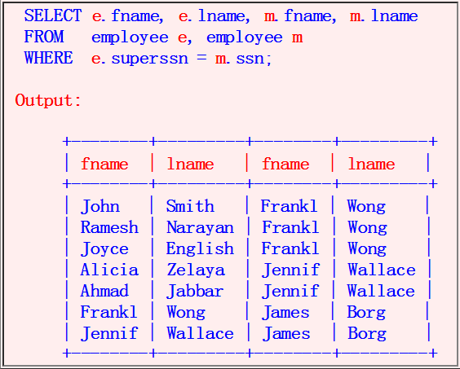
Renaming the Output Attribute Name
Consider the output of the previous query:
The name (title) of the attributes are not very meaningful
Notes:
Qualifying an attribute names with the relation name will not make the attribute name un-ambiguous
(Because it's the same relation name !!!)

Slide 8
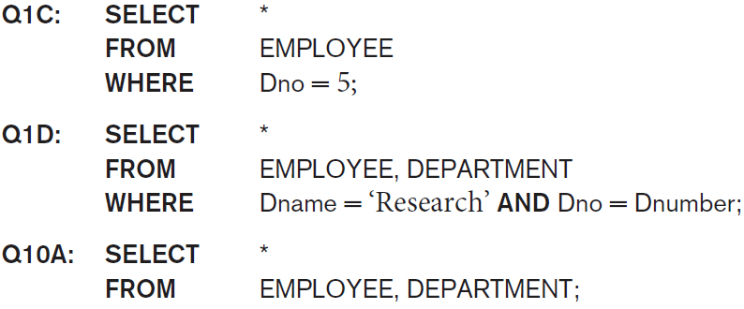
The * Selector
The SELECT * selects all attributes in all relations in the FROM clause

Slide 9
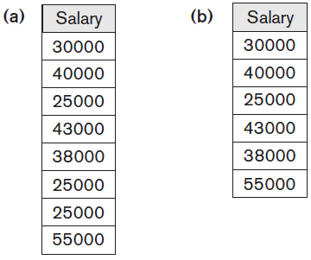
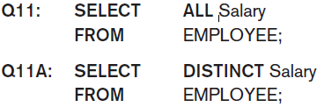
Tables as Sets in SQL
SQL usually treats a table not as a set:
Duplicate tuples can appear more than once in a table, and in the result of a query
But an SQL table with a key is restricted to being a set
Use the DISTINCT keyword in the SELECT clause to remove duplicate values
Retrieve the salary of every employee and all distinct salary values
Notes:
Duplicate elimination is an expensive operation. One way to implement it is to sort the tuples first and then eliminate duplicates.
The user may want to see duplicate tuples in the result of a query.
When an aggregate function (see Section 7.1.7) is applied to tuples, in most cases we do not want to eliminate duplicates.

Slide 10
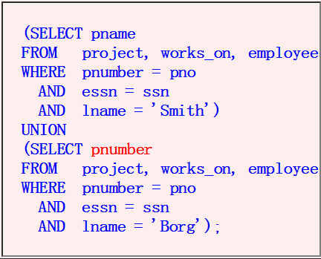
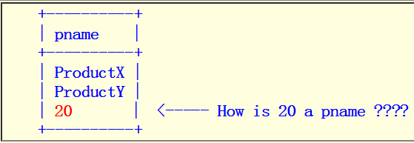
Tables as Sets in SQL (cont.)
Recall that Relational Algebra has the following set operators
∪ (set union)
∩ (set intersection)
− (set difference)
× (Cartesian product)
Example: MySQL (version 5.5.24) will even accept the following UNION:
MySQL do not know about the meaning of each attribute

Slide 11
Other Tuple Conditions
We have seen that you can use "ordinary" Boolean conditions in the where clause
Other tuple conditions
The membership test operator (IN and NOT IN)
The any selection operator (ANY)
The all selection operator (ALL)
The non-empty set test operator (EXISTS)
The null test operator (IS NULL)
Wild card characters ( _ and %)
Notes:
Qualifying an attribute names with the relation name will not make the attribute name un-ambiguous
(Because it's the same relation name !!!)

Slide 12
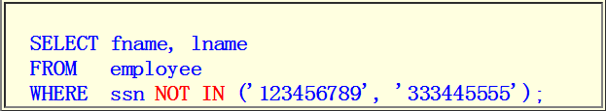
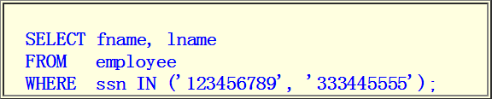
The IN and NOT-IN Comparison Operator
The comparison operator IN tests whether a value is contained in a set
Syntax: attr IN ( set of values )
Example:
Find the fname and lname of employees whose SSN is 123456789 or 333445555
Find the fname and lname of employees whose SSN is not equal to 123456789 or 333445555
Notes:
The (Boolean) expression evaluates to true if attr is a member of the ( set of values )
The (Boolean) expression evaluates to false otherwise

Slide 13
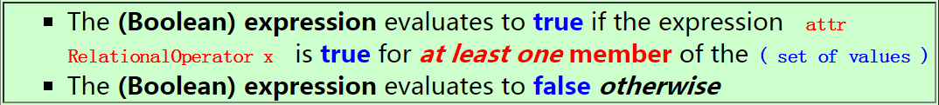
The ANY Selection Operator
ANT
Syntax: attr RelationalOperator any ( set of values )
Meaning:
Example:
SELECT fname, lname
FROM employee
WHERE salary >= ANY ( 30000, 50000 )
Note: why is the above quey illegal?
In the SQL syntax, you cannot use an explicit set of value
Instead, you must use a subquery that returns a set of values
Notes:
The (Boolean) expression evaluates to true if attr is a member of the ( set of values )
The (Boolean) expression evaluates to false otherwise

Slide 14
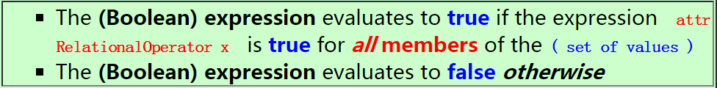
The ALL Selection Operator
All
Syntax: attr RelationalOperator all ( set of values )
Meaning:
Example
SELECT fname, lname
FROM employee
WHERE salary >= ALL ( 30000, 50000 )
Notes:
The (Boolean) expression evaluates to true if attr is a member of the ( set of values )
The (Boolean) expression evaluates to false otherwise

Slide 15
The ! = ALL Selection Operator
Example: ! = ALL
SELECT fname, lname
FROM employee
WHERE ssn != ALL ('111-11-1111', '222-22-2222’)
x != ALL (set of values) is the same as x NOT IN (set of values)
x = ANY (set of values) is the same as x IN (set of values)
Notes:
The (Boolean) expression evaluates to true if attr is a member of the ( set of values )
The (Boolean) expression evaluates to false otherwise

Slide 16
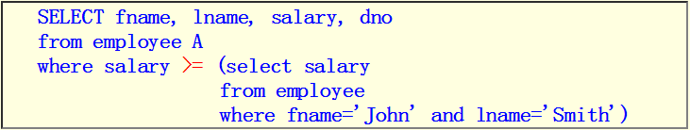
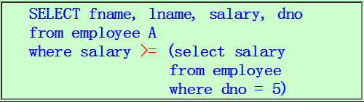
Relations of One Tuple
Example:
Find employees who salary is greater than or equal to John Smith
Another one
Because there is only one salary value for 'John Smith', we can leave of ALL or ANY in the set clause.
If you omit ALL or ANY keywords on a set of size ≥ 2, SQL will report an error !!!
Because this query returns more than 1 tuple !
You get this error: Subquery returns more than 1 row
Notes:
The (Boolean) expression evaluates to true if attr is a member of the ( set of values )
The (Boolean) expression evaluates to false otherwise

Slide 17

The EXISTs and IS NULL
Exists (set of values)
Example:
exists ( 'a', 'b' ) // returns true
exists ( ) // returns false
IS NULL: testing for null values
Find all employee tuples that has a NULL value in the salary attribute:

Slide 18
LIKE: Wildcard String Comparison
Example: Find fname and lname of employees whose last name start with an ‘S’?
When comparing strings, you can use the LIKE operator to perform wildcard string comparison
Example: Find fname and lname of employees whose last name start with an 'S’
Solution:
SELECT fname, lname
FROM E.mployee
WHERE lname LIKE 'S%'
Percent (%) matches 0 or more characters

Slide 19
LIKE: Wildcard String Comparison (cont.)
Example: Find all employees who were born during the 1970s
Solution:
Wildcards can ONLY be used with the LIKE operator
The following query will find people with last name equal to 'S%':
SELECT Fname, Lname
FROM EMPLOYEE
WHERE Bdate LIKE ‘_ _ 7 _ _ _ _ _ _ _’;
Underscore (_) matches exactly one character
SELECT fname, lname
FROM employee
WHERE lname = 'S%'

Slide 20
More Tuple Conditions
Another feature allows the use of arithmetic in queries
+, −, *, and division /
Example: Show the resulting salaries if every employee working on the ‘ProductX’ project is given a 10% raise.
SELECT E.Fname, E.Lname, 1.1 * E.Salary AS Increased_sal
FROM EMPLOYEE AS E, WORKS_ON AS W, PROJECT AS P
WHERE E.Ssn = W.Essn AND W.Pno = P.Pnumber AND P.Pname = ‘ProductX’;

Slide 21
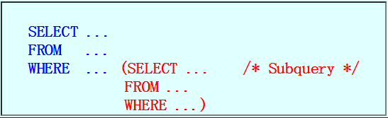
Nested Queries
Nested query
A nested query is a SELECT query where the WHERE clause contains subquery.
In theory, nesting can be arbitrarily deep

Slide 22
Examples of simple (= non-correlated) nested queries
Query 1:
Find fname, lname of employees in the "Research" department
Solution: using a NON-nested query (uses a join):
Solution using a nested query
SELECT fname, lname
FROM employee, department
WHERE dno = dnumber AND dname = 'Research'

Slide 23
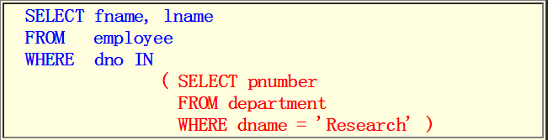
Examples of simple (= non-correlated) nested queries (cont.)
Suppose we know that the 'Research' department has the department number 5, we can write the query as:
We can use a subquery to find the department number of the Research department:
( SELECT dnumber FROM department WHERE dname = 'Research’ )
Therefore, the solution can be expressed as a nested query as follows:
SELECT fname, lname
FROM employee
WHERE dno = 5

Slide 24
Examples of simple (= non-correlated) nested queries (cont.)
Query 2:
Find fname, lname of employees that do not have any dependent
1) Conceptual solution
2) Which is equivalent to:
3) We can write this in SQL as:
SELECT fname, lname
FROM employee
WHERE ssn IN
{ ssn of employees without dependent }
SELECT fname, lname
FROM employee
WHERE ssn NOT IN
(SELECT essn
FROM dependent);
SELECT fname, lname
FROM employee
WHERE ssn NOT IN
{ ssn of employees with (one or more) dependent }

Slide 25
Correlated Nested Queries
So far, the nested queries above are uncorrelated:
The inner (sub)query is a stand-alone query that can be executed independently from the outer query
Example:
The inner query is completely independent from the outer query.
SELECT fname, lname
FROM employee
WHERE ssn NOT IN
(SELECT essn /* Can be executed by itself */
FROM dependent)

Slide 26
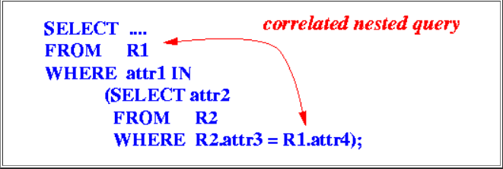
Correlated Nested Queries (cont.)
Correlated nested query
A query where the inner query (i.e., the query in the WHERE clause) uses one or more attributes from relation(s) specified in the outer query.
The attribute attr4 of the relation R1 in the outer query is used in the inner query

Slide 27
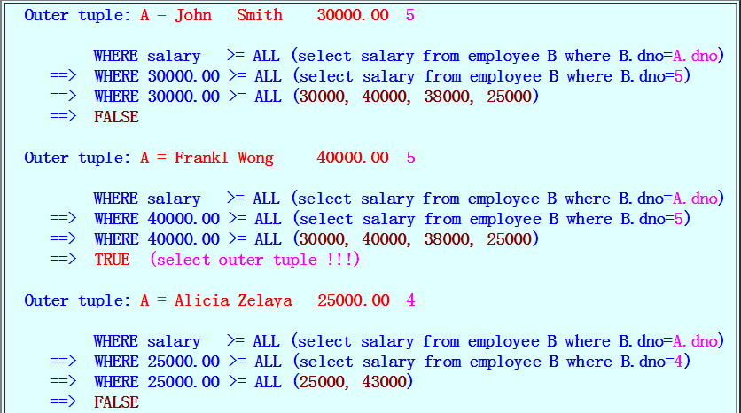
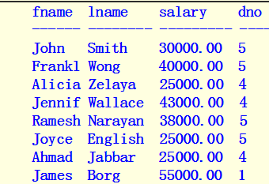
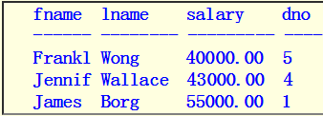
Meaning of Nested Query
Consider the following example of a nested query:
Suppose the employee relation contains the following tuples:
SELECT fname, lname, salary, dno
FROM employee A
WHEre salary >= ALL (select salary
from employee B
where B.dno=A.dno)
Output:
Notes:
The fname, lname, salary, dno of employees whose salary is greater than or equal to the salary of all employees in his/her own department !!!

Slide 28
Examples on How to Use Correlated Nested Queries
Example 1: Find fname, lname of employees that do not have any dependent
SELECT fname, lname
FROM employee
WHERE ( select *
from dependent
where essn = employee.ssn)
= empty set
SELECT fname, lname
FROM Employee
WHERE { set of dependents of this employee }
= empty set
SELECT fname, lname
FROM employee
WHERE not exists (select *
from dependent
where essn = employee.ssn)

Slide 29
Examples on how to use correlated nested queries (cont.)
Example 2: Find fname, lname of employees that do not work on any project controlled by the Research department
SELECT fname, lname
FROM Employee A
WHERE { set of projects w.o. by employee A
and controlled by Research dept }
= empty set
SELECT fname, lname
FROM Employee A
WHERE not exists
{ set of projects w.o. by employee A
and controlled by Research dept }
SELECT fname, lname
FROM employee A
WHERE not exists
(select *
from projects
where pnumber in ( project w.o. by employee A )
and pnumber in ( project controlled by Research dept ) )
SELECT fname, lname
FROM employee A
WHERE not exists
( select *
from projects
where project w.o. by employee A
and project controlled by Research dept )

Slide 30
Examples on how to use correlated nested queries (cont.)
Example 2 (cont.): Find fname, lname of employees that do not work on any project controlled by the Research department
SELECT fname, lname
FROM employee A
WHERE not exists
(select *
from project
where pnumber in (select pno
from works_on
where essn = A.ssn )
and
pnumber in (select pnumber
from project, department
where dnum = dnumber and dname = 'Research' ) )

Slide 31
Ordering of Query Results
ORDER BY clause
Order the tuples in the result of a query by the values of one or more of the attributes that appear in the query result
Example:
Retrieve a list of employees and the projects they are working on, ordered by department and, within each department, ordered alphabetically by last name, then first name.
SELECT D.Dname, E.Lname, E.Fname, P.Pname
FROM DEPARTMENT AS D, EMPLOYEE AS E, WORKS_ON AS W, PROJECT AS P
WHERE D.Dnumber = E.Dno AND E.Ssn = W.Essn AND W.Pno = P.Pnumber
ORDER BY D.Dname, E.Lname, E.Fname;

Slide 32

INSERT, DELETE, and UPDATE Statements in SQL
The insert command
The INSERT command can be used to insert one or more tuples into a relation
Format 1: inserting one complete tuple:
Must specify all attribute values in the exact order at the relation schema
Format 2: inserting a partial tuple
Specify a subset of the attribute values in the any order
INSERT INTO employee(fname, lname, ssn)
VALUES ('Richard', 'Marini', '222669999');
NOTE: The attributes not in the list are given their DEFAULT or NULL value
Notes:
This is useful if a relation has many attributes but only a few of those attributes are assigned values in the new tuple.

Slide 33



INSERT Command in SQL
DBMS should enforce all the integrity constraints due to insert command
How about the following insert operation
Notes:
This is useful if a relation has many attributes but only a few of those attributes are assigned values in the new tuple.

Slide 34
INSERT Command in SQL
Inserting a tuple using the result from a SELECT command
Syntax: INSERT INTO relationName (SELECT ...)
Example:
To create a temporary table that has the employee last name, project name, and hours per week for each employee working on a project
CREATE TABLE WORKS_ON_INFO
( Emp_name VARCHAR(15), Proj_name VARCHAR(15), Hours_per_week DECIMAL(3,1) );
INSERT INTO WORKS_ON_INFO ( Emp_name, Proj_name, Hours_per_week )
SELECT E.Lname, P.Pname, W.Hours
FROM PROJECT P, WORKS_ON W, EMPLOYEE E
WHERE P.Pnumber = W.Pno AND W.Essn = E.Ssn;
Need to keep a view to keep table up to data
Notes:
A table WORKS_ON_INFO is created by U3A and is loaded with the joined information retrieved from the database by the query in U3B.
Notice that the WORKS_ON_INFO table may not be up to date; that is, if we update any of the PROJECT,WORKS_ON, or EMPLOYEE relations after issuing U3B, the information in WORKS_ON_INFO may become outdated. We have to create a view to keep such a table up to date.

Slide 35
DELETE Command in SQL
Delete one or more tuples from a relation using the DELETE command.
Syntax:
Example 1: Delete all employees from the 'Research' department
DELETE FROM relationName
WHERE tuple-boolean-condition
DELETE FROM Employee
WHERE dno IN (SELECT dnumber
FROM department
WHERE dname = 'Research')

Slide 36
DELETE Command in SQL (cont.)
Example 3:
Delete all employees from the 'Research' department have more than 2 dependents:
DELETE FROM employee
WHERE dno IN ( SELECT dnumber
FROM department
WHERE dname = 'Research')
AND ssn IN ( SELECT essn
FROM dependent
GROUP BY essn
HAVING COUNT(name) > 2)

Slide 37
UPDATE Command in SQL
Update one attribute value in one or more tuples from a relation using the UPDATE command
Syntax:
Example1: Change the address of employee 'John Smith' to '123 Pike Lane, Austin, TX’
UPDATE relationName
SET attributeName = expression
WHERE tuple-boolean-condition
UPDATE employee
SET address = '123 Pike Lane, Austin, TX'
WHERE fname = 'John’ AND lname = 'Smith';

Slide 38
UPDATE Command in SQL (cont.)
Example2: Give all employees in the 'Research' department a 10% raise
UPDATE Employee
SET salary = 1.1 * salary
WHERE dno IN ( SELECT dnumber
FROM department
WHERE dname = 'Research')

